Slide 1
Data Parallelism
The Parallel Class and PLINQ
Brandon Minnick
Code Traveler, LLC
Notes:
Welcome to data parallelism. So far today you have used many threads by accident and had to make shared state safe, and you have coordinated a handful of independent calls with Task.WhenAll. This section is a different shape of problem. Here you have one operation and thousands of items, and you want every core in the machine working on them at once. .NET gives you two answers. The Parallel class is the imperative one: Invoke, For, ForEach, and the asynchronous siblings ForAsync and ForEachAsync. PLINQ is the declarative one: write the LINQ query you already know, append AsParallel, and the runtime partitions and merges for you. We will cover both, then look at the one trap that makes Parallel.ForEach quietly do nothing at all. That trap is sitting in the app you are about to fix, and it ships more often than you would like to believe. https://learn.microsoft.com/dotnet/standard/parallel-programming/

Slide 2
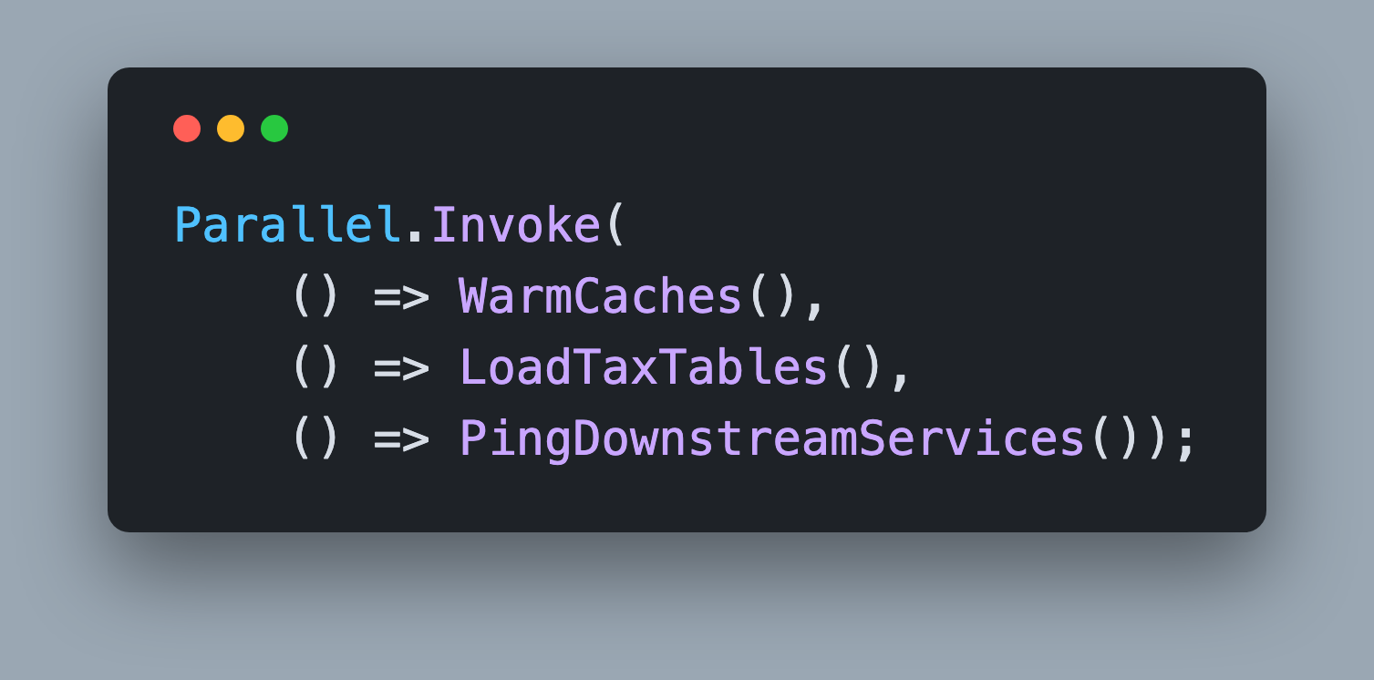
Parallel.Invoke()
System.Threading.Tasks.Parallel
Runs Multiple Actions in Parallel
Blocking Call
    Does not yield the calling thread
Notes:
Parallel.Invoke is the simplest member of the class. Hand it several actions, or an Action array, and it runs them in parallel and returns when the last one finishes. It is a blocking call: it does not yield the calling thread, so never put it on a UI thread or in a request handler where you meant to await something. You are probably wondering why not just use Task.WaitAll. Two reasons, and one tradeoff. Performance: Invoke runs one of the actions inline on the calling thread instead of queueing it, and if you pass exactly one action it just runs it. Exception handling: when the loop is cancelled, Invoke collapses the OperationCanceledExceptions into a single OperationCanceledException instead of an AggregateException wrapping them. Every other failure comes back as an AggregateException, exactly like Task.WaitAll, and neither one flattens a nested AggregateException your action threw. The tradeoff is that you never create the tasks yourself, so you have no control over TaskCreationOptions. https://github.com/dotnet/runtime/blob/b146d7512ce67051e127ab48dc2d4f65d30e818f/src/libraries/System.Threading.Tasks.Parallel/src/System/Threading/Tasks/Parallel.cs#L352

Slide 3
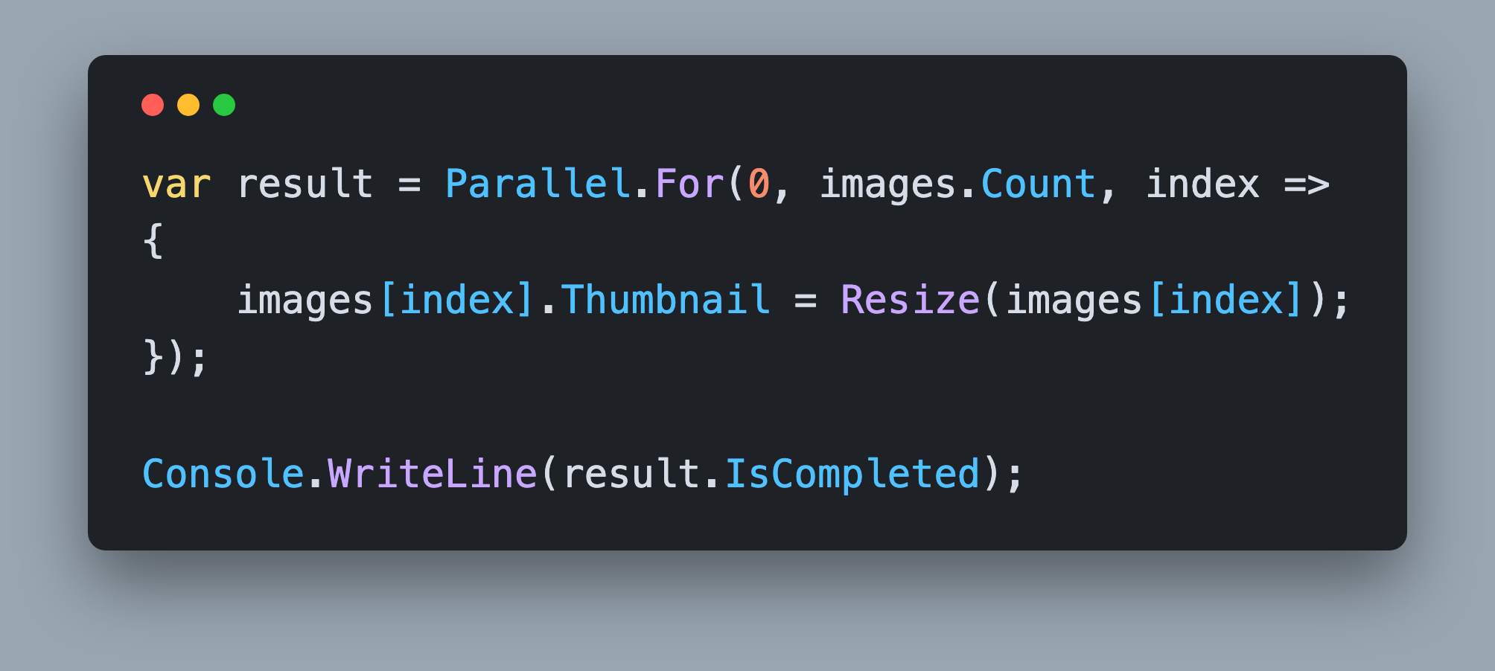
Parallel.For()
System.Threading.Tasks.Parallel
Runs a For Loop in Parallel
Blocking Call
Returns `ParallelLoopResult`
Notes:
Parallel.For is the for loop you already write, with the iterations spread across the thread pool. The range is exclusive at the top, exactly like a normal for loop, and the body receives the index. The rule that makes this safe is visible in the snippet: each iteration touches only the element at its own index, so no iteration can see a value another iteration is writing. If your loop body increments a shared counter or appends to a shared List, this transformation is not safe and you will lose data. Notice the return value. Parallel.For hands back a ParallelLoopResult, and its IsCompleted property tells you whether every iteration ran. It is false when the body called ParallelLoopState.Break or Stop to end the loop early, which is how you check that a parallel loop actually finished its work. https://learn.microsoft.com/dotnet/api/system.threading.tasks.parallelloopresult

Slide 4
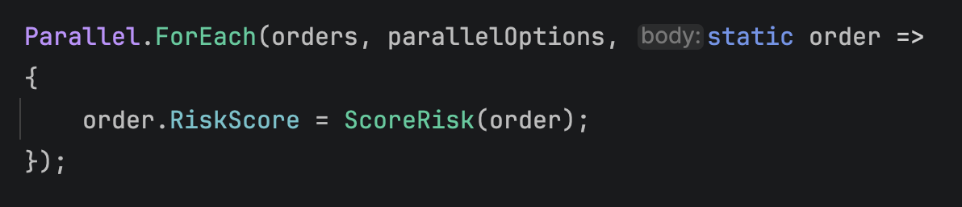
Parallel.ForEach()
System.Threading.Tasks.Parallel
Runs a ForEach Loop in Parallel
Takes an `Action<T>`
  Do not use async
Blocking Call
  Does not yield the calling thread
ParallelOptions
  `CancellationToken` and `MaxDegreeOfParallelism`
Notes:
Parallel.ForEach is the same idea over an IEnumerable instead of a range. It partitions the source, hands each partition to a thread pool worker, and blocks until every item has been processed. Read the second bullet slowly, because the whole challenge hangs off it. The body parameter is an Action of T. It returns void. There is no overload of Parallel.ForEach that takes a Func returning Task, so there is nothing there that can await your work. Like Parallel.For, it is a blocking call and it does not yield the calling thread, which makes it a poor fit inside a request handler unless you genuinely have CPU work to burn. Every Parallel method has an overload that takes a ParallelOptions, and that is where you set your cancellation token and your concurrency ceiling. The shorter overloads that omit it are the ones that give you no limits at all. https://learn.microsoft.com/dotnet/api/system.threading.tasks.parallel.foreach

Slide 5
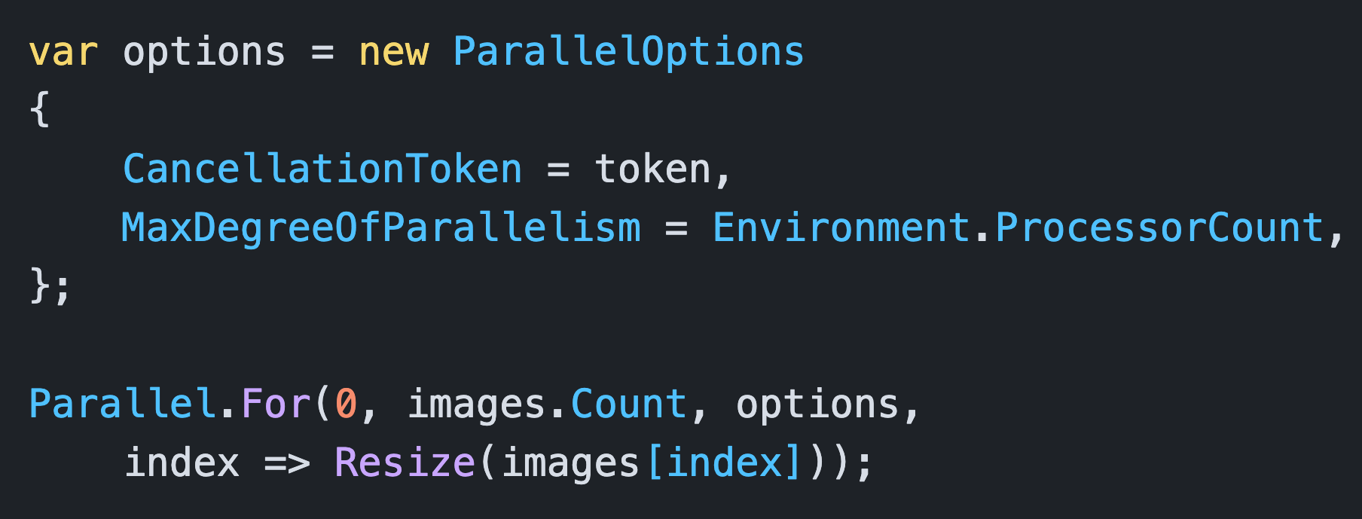
ParallelOptions
One place for your limits
MaxDegreeOfParallelism caps how many run at once
    For / ForEach / Invoke: `-1` lets the thread pool decide
    ForAsync / ForEachAsync: `-1` means `Environment.ProcessorCount`
Notes:
ParallelOptions is a small object that carries the two settings you will actually change. MaxDegreeOfParallelism caps how many iterations run at the same time, and it defaults to negative one. Read the sub-bullets carefully, because negative one does not mean the same thing everywhere. For Parallel.For, ForEach and Invoke it means the runtime decides, limited only by the thread pool. For the asynchronous overloads, ForAsync and ForEachAsync, negative one is converted to Environment.ProcessorCount, so leaving it alone quietly caps I/O work at your core count, which is usually far too low. Set it deliberately. CancellationToken lets the loop stop between iterations, and the Parallel call then throws OperationCanceledException instead of quietly leaving half the work running. There is a third property, TaskScheduler, which you will almost never set. Create one options object per kind of work, not one per method: CPU-bound loops want a ceiling near your core count, and I/O-bound loops want whatever the downstream service tolerates. https://learn.microsoft.com/dotnet/api/system.threading.tasks.paralleloptions

Slide 6
Parallel.ForEach Takes an Action
Don’t use async. An `async` lambda there becomes `async void`, and nothing waits for it.
Notes:
This is the slide to remember from this section, so it is worth reading twice. When you write an async lambda, the compiler picks the delegate type from the context. Bind it to a Func returning Task and you get an async Task method. Bind it to something that returns void, like Action of T, and you get an async void method. The only single-argument body Parallel.ForEach offers is Action of T. It does have Func overloads, but they exist for thread-local accumulation, where the body returns TLocal and never a Task, so there is still nothing for the compiler to bind an async lambda to except Action of T. Async void means the caller has no handle on the work. ForEach invokes your lambda, the lambda runs to its first await, returns immediately, and ForEach considers that item finished. It does this 4,000 times and returns. https://learn.microsoft.com/dotnet/csharp/language-reference/operators/lambda-expressions

Slide 7
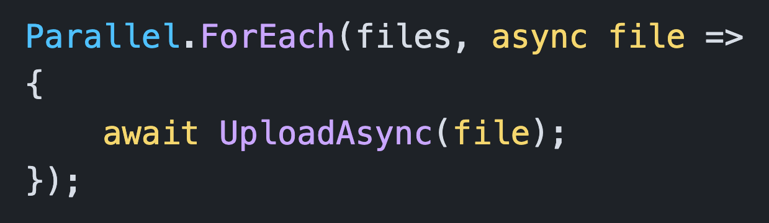
The `async void` Trap
It compiles. It does nothing.
The lambda binds to `Action<T>`
`ForEach` returns before one upload finishes
No warning, no work, and any failure crashes the process
Notes:
Here is what it looks like in the wild. Four lines, entirely reasonable at a glance, and reviewers approve it every day. The compiler cannot warn you, because binding an async lambda to Action of T is legal C# and is sometimes what you want, for example an event handler. So there is no squiggle, no CS4014, nothing in the build log. At runtime, Parallel.ForEach starts 4,000 state machines, each of which hits its first await and returns, and ForEach reports that it is done. The measurement you take right after it is meaningless. Do not read nobody waiting for it as harmless. If UploadAsync throws, the state machine rethrows the exception on the captured SynchronizationContext, or on the thread pool when there is none, and an unhandled thread pool exception terminates the process. The try block you carefully wrote around the loop never sees it. The fix is not a lock or a Wait. The fix is the overload that understands asynchronous bodies. https://learn.microsoft.com/dotnet/csharp/asynchronous-programming/

Slide 8
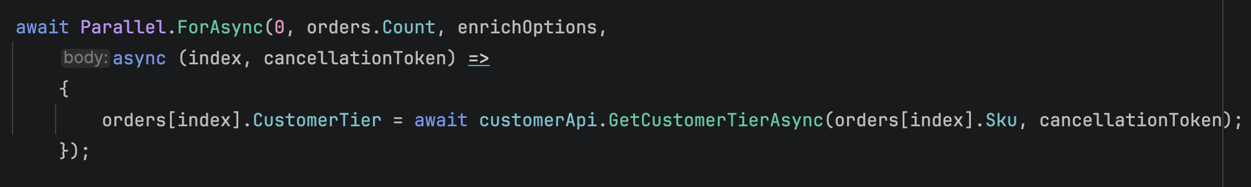
Parallel.ForAsync()
System.Threading.Tasks.Parallel
Runs a For Loop in Parallel for asynchronous operations
Returns a `Task`
  Always `await` it
ParallelOptions
  `CancellationToken`
  `MaxDegreeOfParallelism`
Notes:
Parallel.ForAsync arrived in .NET 8 and is the asynchronous twin of Parallel.For. It walks a numeric range, but the body is a Func taking the index and a CancellationToken and returning a ValueTask. That signature is the whole point: because the body returns something awaitable, ForAsync can await it, and the Task that ForAsync returns does not complete until every body has completed. So you await ForAsync, and when that await finishes the work is genuinely done. Compare that to Parallel.For, which blocks a thread while it waits. ForAsync does not block: it releases the calling thread the way any other await does, which is what you want inside a request handler or a Blazor component. The same ParallelOptions applies, so you still control cancellation and the maximum number of bodies in flight, and here the default really is your core count. https://learn.microsoft.com/dotnet/api/system.threading.tasks.parallel.forasync

Slide 9
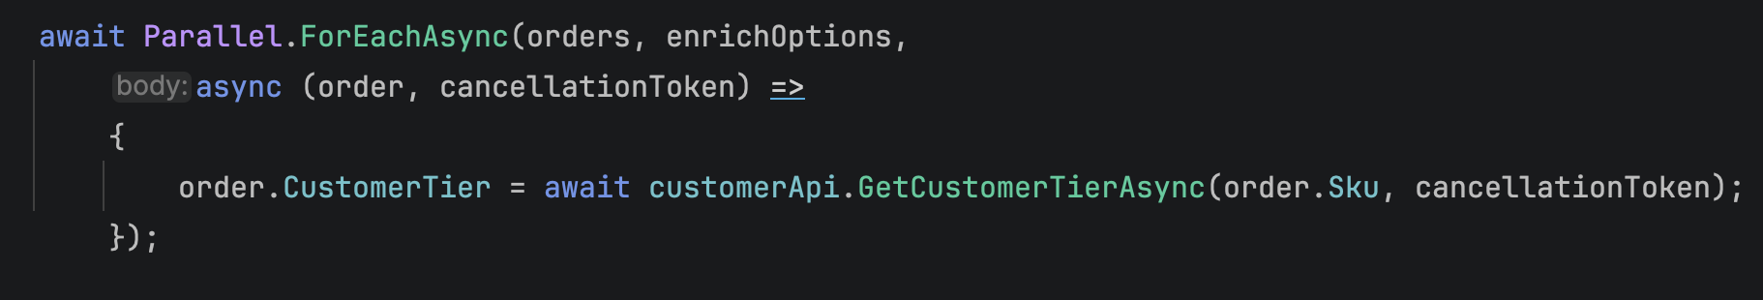
Parallel.ForEachAsync()
System.Threading.Tasks.Parallel
Runs a ForEach Loop in Parallel for asynchronous operations
Body is `Func<T, CancellationToken, ValueTask>`
Awaits every body before the returned `Task` completes
Also accepts `IAsyncEnumerable<T>`
`MaxDegreeOfParallelism` is your rate limit
Notes:
Parallel.ForEachAsync has been in the framework since .NET 6, and it is the method the broken code on the earlier slide wanted. Same collection, same idea, but the body is a Func taking the item and a CancellationToken and returning a ValueTask. Because the body is awaitable, ForEachAsync awaits it, so nothing is lost and exceptions come back to you. It also accepts IAsyncEnumerable of T, which is handy when the source itself is streamed from a database or an API. The last bullet is the one that saves you a production incident. For I/O-bound work, MaxDegreeOfParallelism is not a CPU setting, it is a rate limit. Cores are not the constraint when every body is waiting on a network call, and the default here is your core count, so leaving it alone throttles you rather than protecting anyone. Pick the number your downstream service is willing to take. https://learn.microsoft.com/dotnet/api/system.threading.tasks.parallel.foreachasync

Slide 10
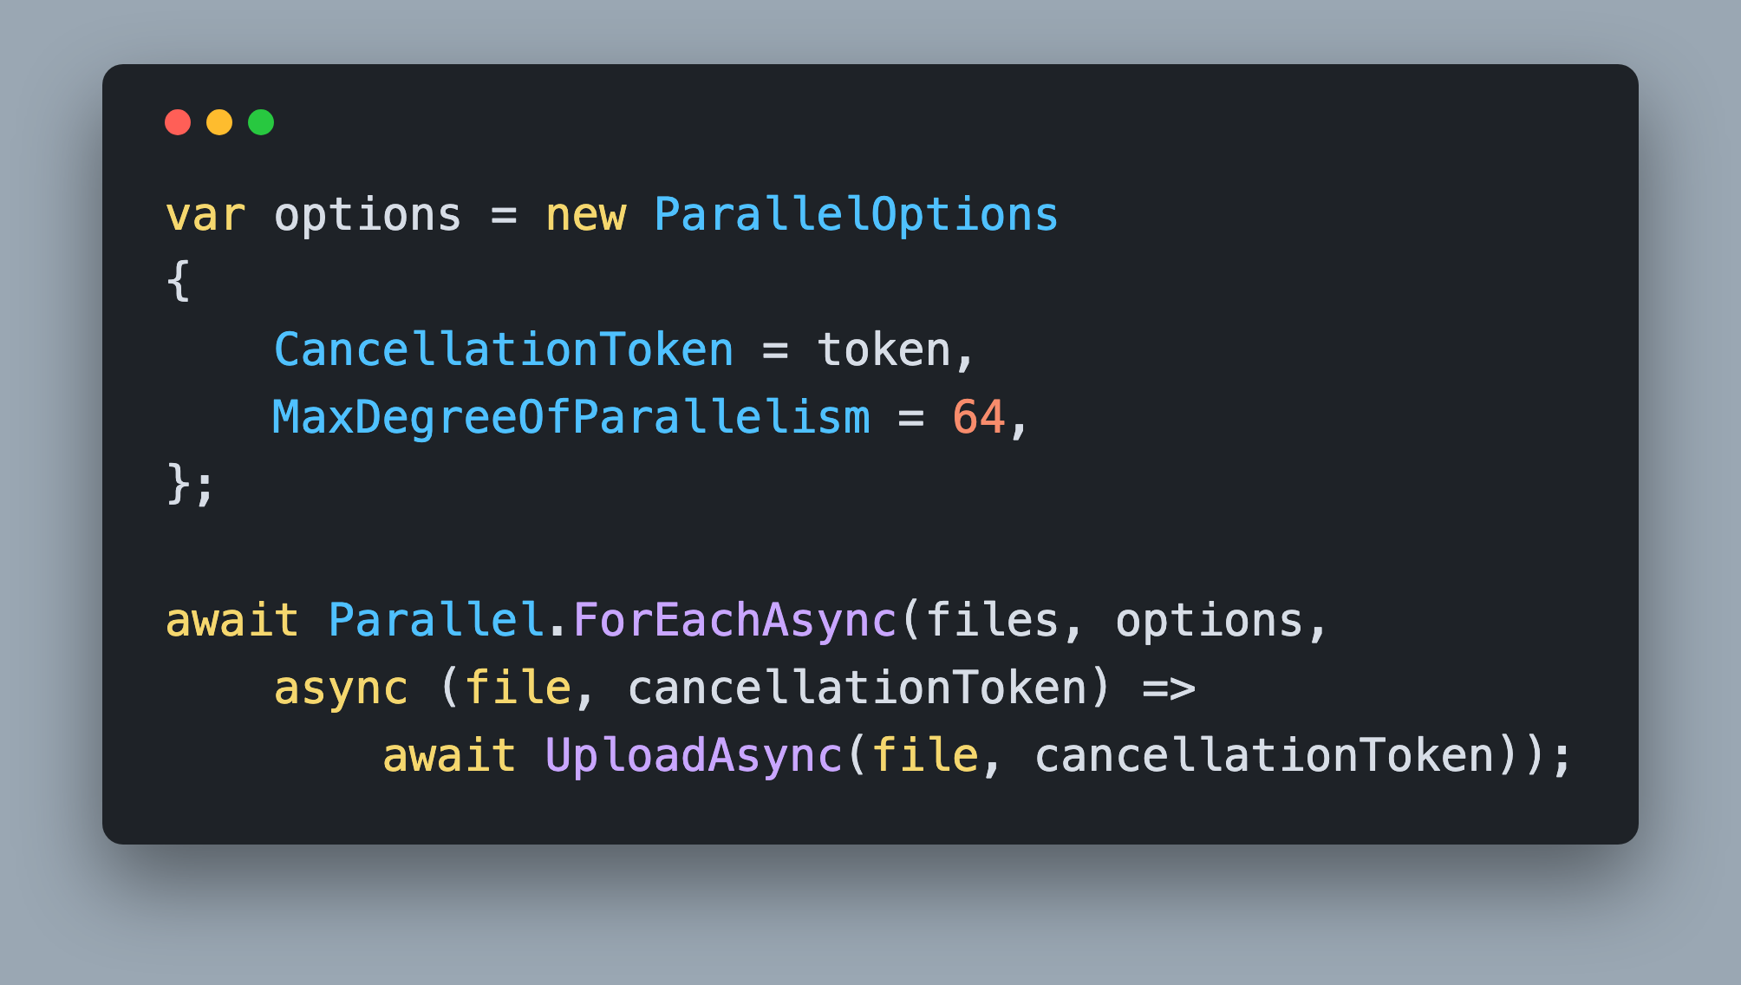
Parallel.ForEachAsync()
Bound the calls, not the cores
I/O-bound work is not limited by cores
Pick the number the downstream service can take
Notes:
Three things to notice. First, the await in front of the call. That is the difference between work that happened and work that was started, and it is why the measurement you take on the next line means something. Second, the degree of parallelism is 64, not Environment.ProcessorCount. Sixty four calls in flight on an eight core machine would be silly for CPU work, but these bodies spend their time waiting on the network, not computing, so cores are the wrong unit. The right number is whatever the service on the other end can absorb without rate limiting you or falling over, and you should be able to say why you picked it. Third, the body receives its own CancellationToken and passes it down. Use that one rather than closing over an outer token: ForEachAsync links your options token with its own and hands you the combined result, so passing it along is what makes cancellation actually stop the calls in flight.

Slide 11
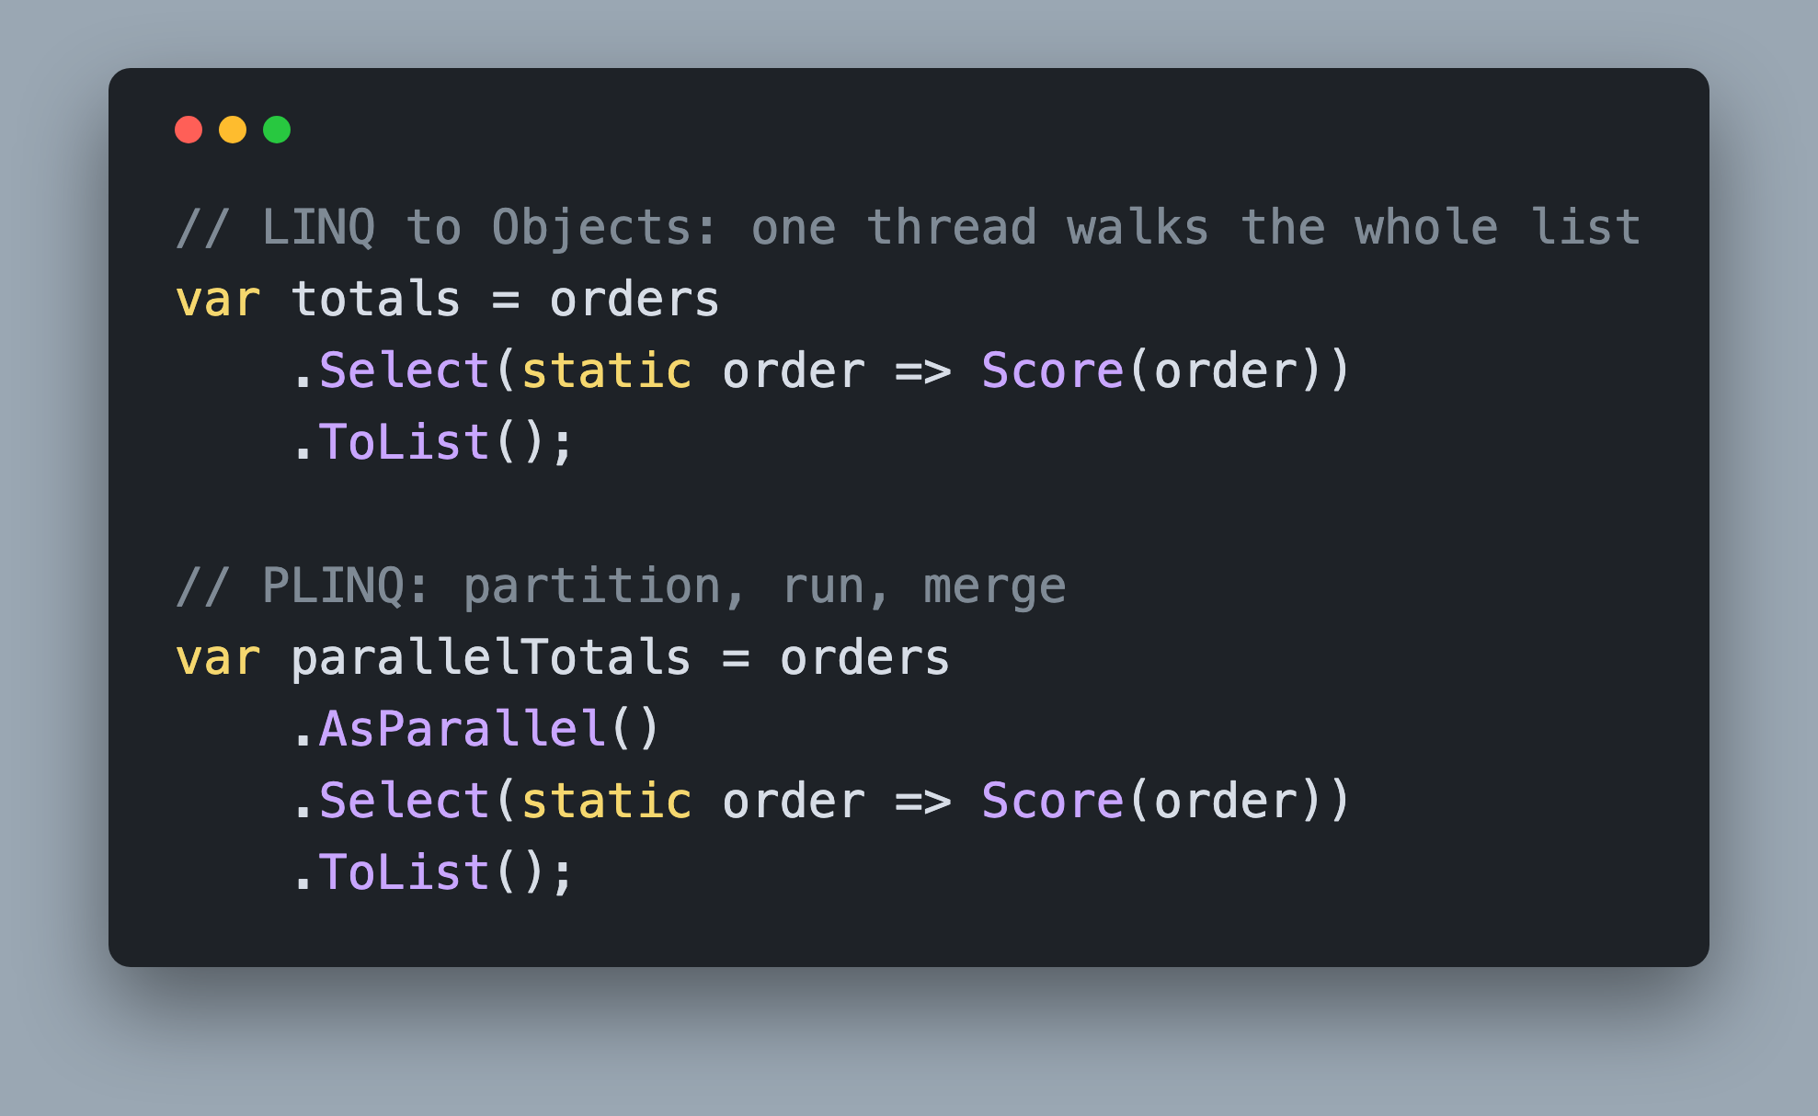
PLINQ
System.Linq.ParallelEnumerable
Append `.AsParallel()` to a LINQ query
Same query shape, same results
    No ordering guarantee without `.AsOrdered()`
Notes:
PLINQ is the declarative sibling of the Parallel class. Take a LINQ to Objects query you already have, append AsParallel, and you are calling into ParallelEnumerable instead of Enumerable. The runtime partitions the source, runs your operators on each partition, and merges the results back. Your Where, Select, GroupBy and aggregate calls do not change, which is what makes it so easy to reach for.
Two behaviors do change. PLINQ guarantees nothing about the order of your results unless you ask, and exceptions from different partitions arrive wrapped in an AggregateException rather than thrown one at a time.
Be careful how you demonstrate that ordering point, because it is subtler than it sounds. A List going into ToList very often comes back in source order anyway, since PLINQ splits an indexable source into ranges and concatenates them in order. Change the source to something it cannot index, or consume the query with foreach instead of ToList, and the order changes. No guarantee means no guarantee, even when it looks fine.
https://learn.microsoft.com/dotnet/standard/parallel-programming/introduction-to-plinq

Slide 12
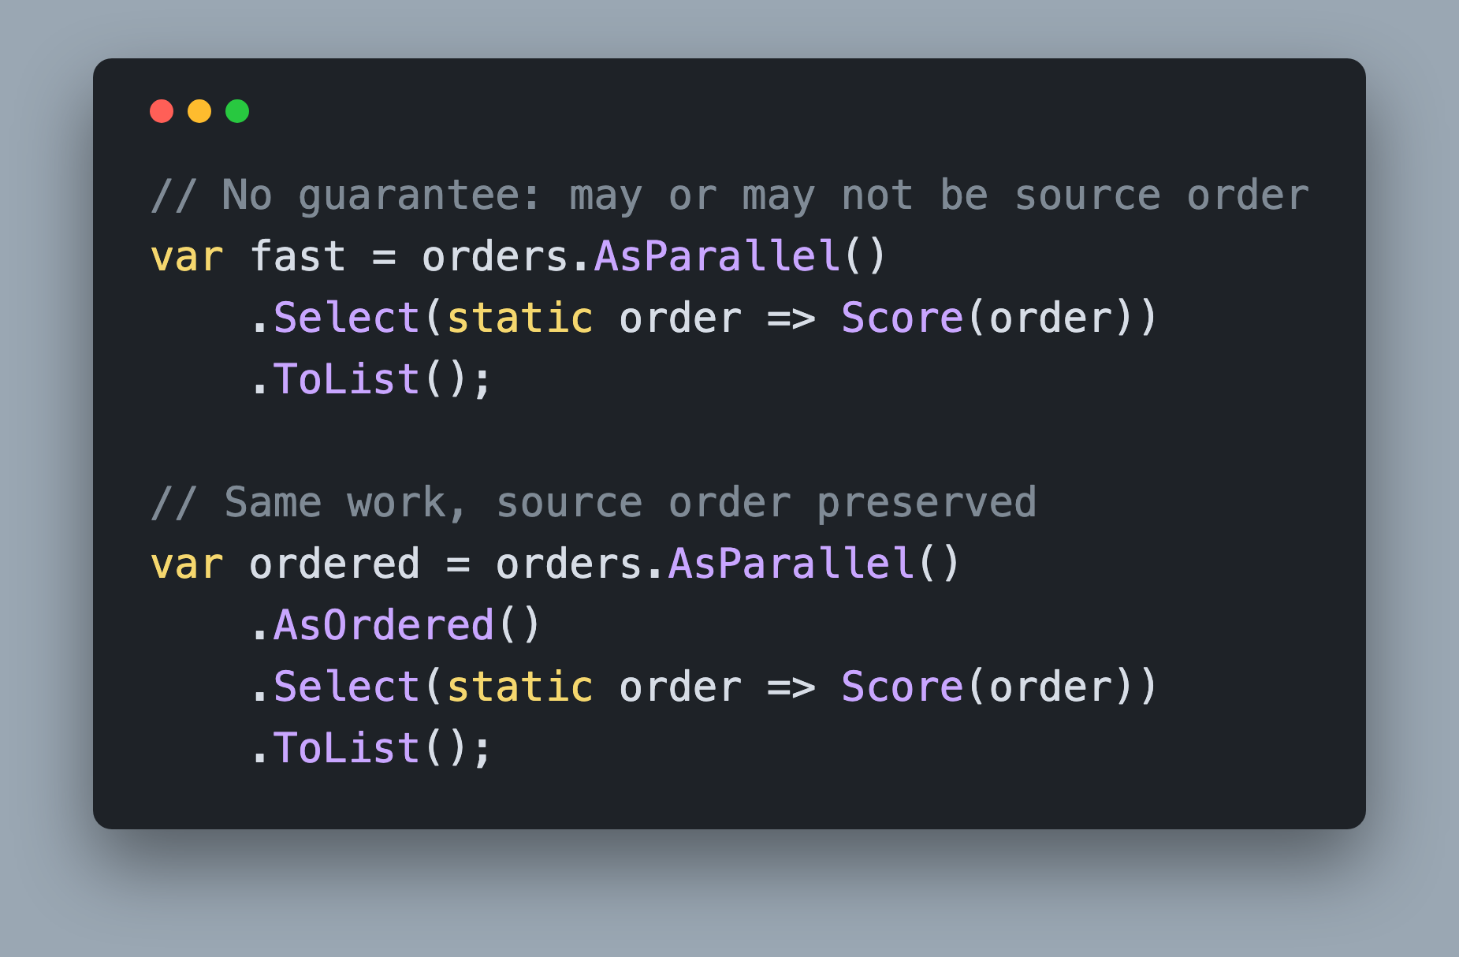
.AsOrdered()
Preserves the Ordering of the Source Sequence
The only way to guarantee source order
`.AsUnordered()` reverts it
Notes:
This is the operator that turns a coincidence into a contract. Without it PLINQ is free to hand you results in any order, and the fact that it frequently hands them back in source order anyway is what makes the bug so expensive. Your test passes on a List, somebody swaps the source for a database reader or a yield return, and suddenly the report rows are shuffled.
AsOrdered tells PLINQ to track each element's position and reassemble the output in source order. That is not free. The merge has to hold on to results it cannot emit yet, so a query that was streaming happily starts buffering, and a slow element early in the sequence holds up everything behind it.
So ask for it when the order is part of the answer, and use AsUnordered to give the guarantee back once you are past the operator that needed it. Apply it to the query right after AsParallel, where a reader can see it.
https://learn.microsoft.com/dotnet/api/system.linq.parallelenumerable.asordered

Slide 13
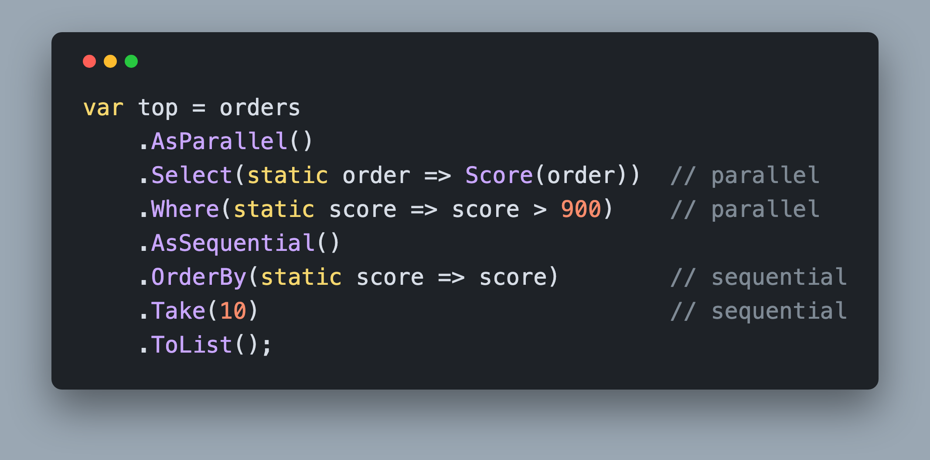
.AsSequential()
Finish the Query on One Thread
Returns `IEnumerable<T>`, not `ParallelQuery<T>`
Everything upstream still ran in Parallel
Does not undo `.AsParallel()`
Notes:
AsSequential is the one people misread. It does not undo AsParallel and it does not rerun anything. It draws a line across the query: every operator above it still ran in parallel, and every operator below it runs on one thread, in order, on the results that come out of the merge.
The return type is the tell. AsParallel gives you a ParallelQuery of T, and AsSequential gives you back a plain IEnumerable of T, so the operators after it are ordinary LINQ again.
You reach for it when one stage is worth parallelizing and the rest is not. The expensive scoring runs on every core, then the cheap ordering and the Take finish sequentially, where a parallel merge would cost more than it saves. It is also the honest escape hatch when an operator does not behave the way you want under PLINQ: run that part sequentially rather than fighting it.
https://learn.microsoft.com/dotnet/api/system.linq.parallelenumerable.assequential

Slide 14
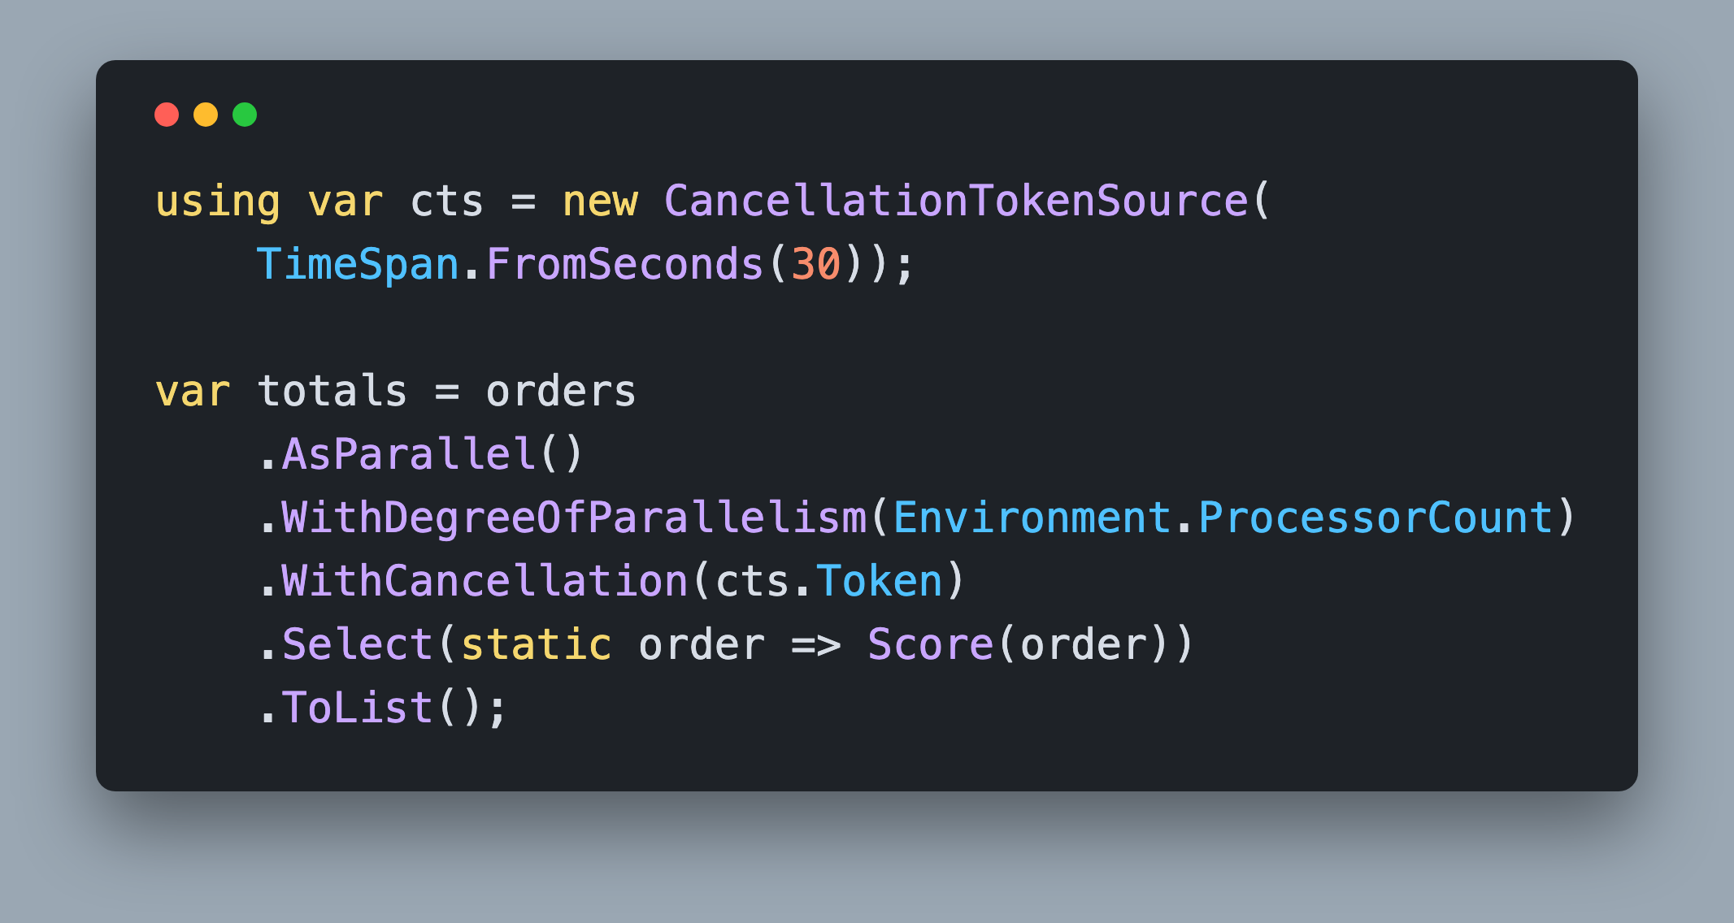
Parallelism and Cancellation
PLINQ
`.WithDegreeOfParallelism(int)`
`.WithCancellation(token)`
    Throws `OperationCanceledException`
Notes:
These are the two you will actually set on a real query. WithDegreeOfParallelism caps how many threads the query uses. PLINQ already defaults to your processor count, so this is almost always a knob you turn down rather than up: down to leave room for the rest of a busy server, or down because the query is really waiting on something shared and more threads just add contention.
WithCancellation hands PLINQ a token so a long query can be stopped. It checks the token between elements, so cancellation is prompt for a query over many cheap items and only as prompt as one call for a query over a few expensive ones. When it does cancel, it throws OperationCanceledException, so a query the user walked away from ends in a catch rather than a wasted core.
Both operators can only be applied once per query, and both belong right after AsParallel where a reader can see them.
https://learn.microsoft.com/dotnet/api/system.linq.parallelenumerable.withdegreeofparallelism

Slide 15
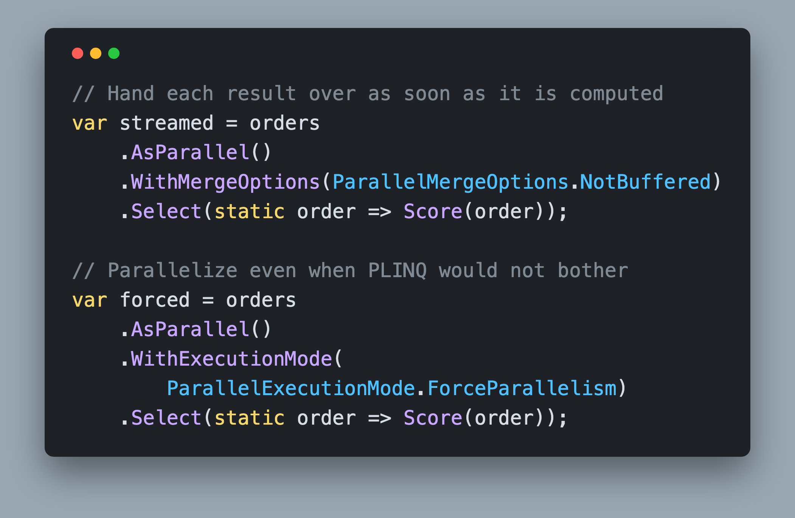
Merge and Execution Mode
PLINQ
`NotBuffered`, `AutoBuffered`, `FullyBuffered`
    AutoBuffered is the default
PLINQ may run your query sequentially anyway
Notes:
Two operators for when the defaults are not right. WithMergeOptions controls how results come back from the partitions. NotBuffered makes each element available as soon as it is computed, which is what you want when something downstream is streaming into a UI. FullyBuffered accumulates everything before the caller sees a single result, which finishes sooner in total but shows nothing until it does. AutoBuffered sits in between and is the default.
WithExecutionMode addresses the thing that surprises people. PLINQ analyzes your query, and if it decides the parallel algorithm would cost more than simply running sequentially, it runs it sequentially and never tells you. That is usually the right call, and it is why appending AsParallel sometimes changes nothing at all. ForceParallelism overrides the decision. Measure before and after, because the analysis is often right.
https://learn.microsoft.com/dotnet/api/system.linq.parallelenumerable.withmergeoptions

Slide 16
Challenge: Fix the Nightly Import
25 minutes
`1. Start/ImportPortal`, http://localhost:5011
Five `// ToDo Refactor (Step N)` comments in `ImportService.cs`
Validate on every core, not one
Actually enrich all 4,000 rows
Bound the calls to the customer API
Summarize with PLINQ, and stop when cancelled
3 of 3 steps pass, both cards green, total time down
Notes:
Your turn. Open the starter, run it, and click Run import before you change anything, so you have your own baseline rather than mine. The workshop guide docked beside the Import page walks you through the challenge one step at a time, and it re-checks your code every time the app starts. Everything you need to change is in ImportService.cs, in RunImportAsync, and the five ToDo Refactor comments mark the spots, each tagged with the step that checks it. Stage one is pure CPU work with no shared state, so it wants every core. Stage two is I/O, currently async void, and it wants the overload that can await your body plus a sensible ceiling on how many calls you make at once. Stage three is a LINQ query that can become a PLINQ query, and Step 3 also cancels an import to make sure every stage honors the token RunImportAsync already receives. Do not change the other services, the model, or the page. When you are done, the guide should show 3 of 3 steps pass, the Validated and Enriched cards should both read 4,000 of 4,000, and the total should be at or below your baseline even though the app is finally doing the work it used to skip.

